Slide 1
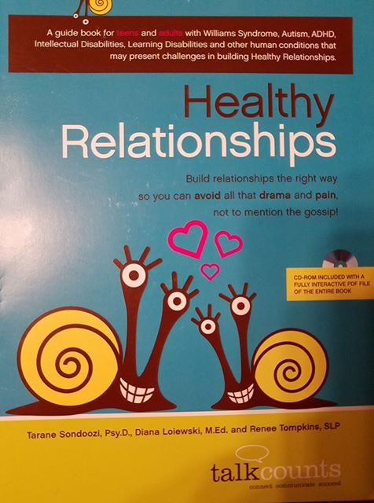

Healthy Relationships
Personal Safety

Slide 2
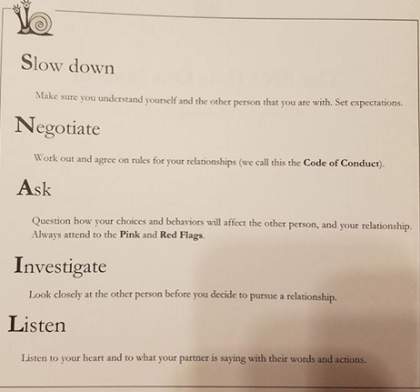
The SNAIL is our Mascot

Slide 3
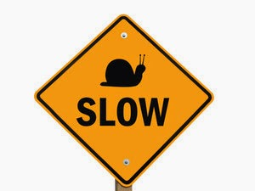
S= Slow Down
Make sure you understand yourself and the other person that you are with.
Set Expectations
Doesn’t move quickly
Snail trail shows where it has been

Slide 4
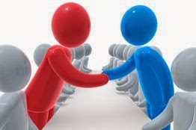
N= Negotiate
Work out and agree on rules for your relationship.
Code of Conduct
Shell is snail’s personal space/home
Set boundaries

Slide 5
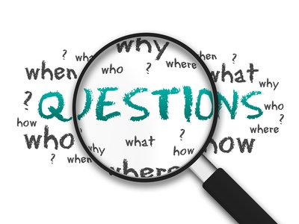


A= Ask
Question how your choices and behaviors will affect the other person and relationship.
Always pay attention to:
Yellow Flags
Red Flags

Slide 6

I= Investigate
Look closely at the other person before you decide to pursue a relationship.
Healthy relationships help
you to be a better person

Slide 7

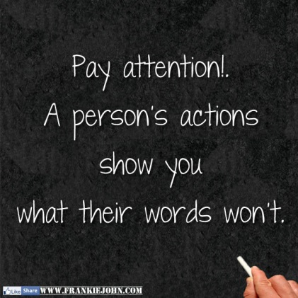
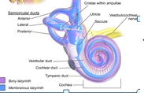
L= Listen
Listen to your heart and what the other person is saying with their words and actions.
Snail’s shell is like a
human’s inner ear
Listen to yourself & your
heart
Listen to what your friend
is feeling or saying

Slide 8
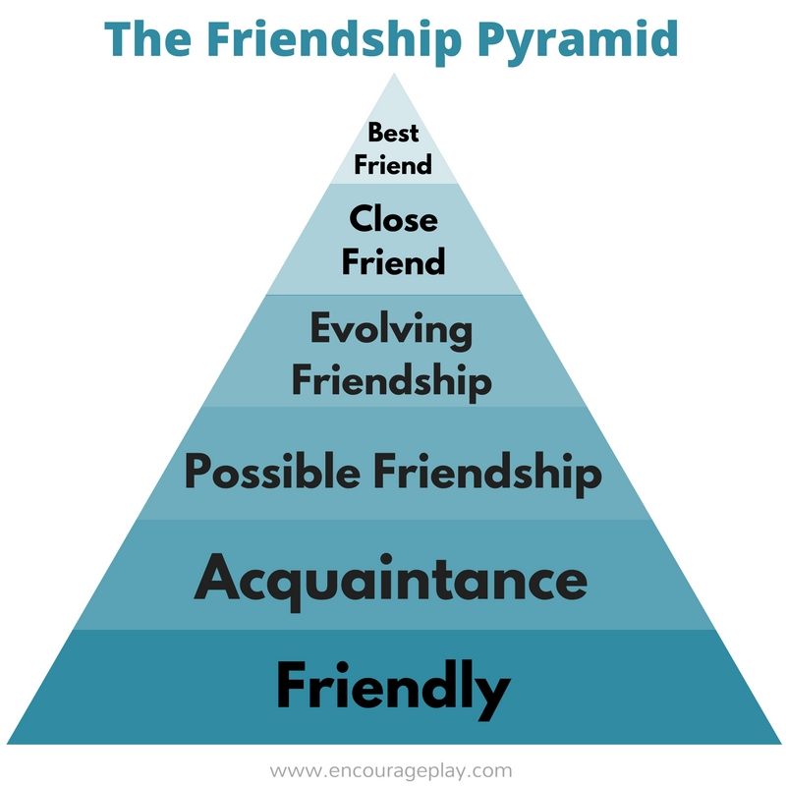

Slide 9
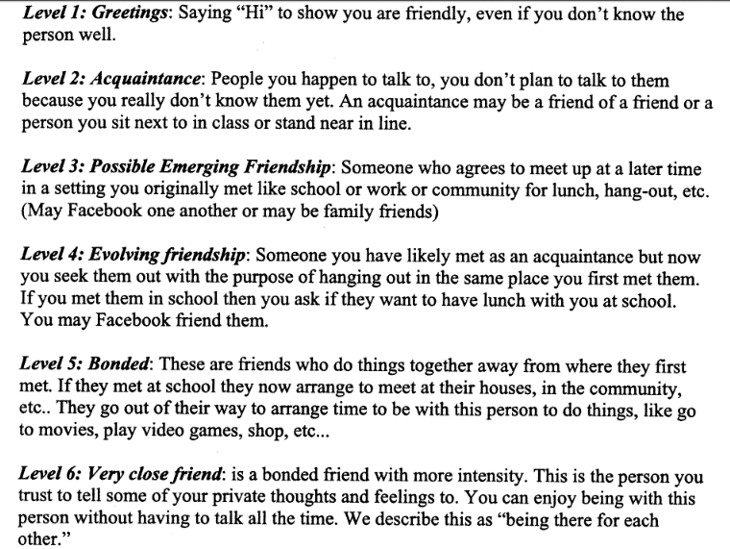

Slide 10

Safety First
Our number one rule is safety first.
What do you need to do to be safe at all times?

Slide 11
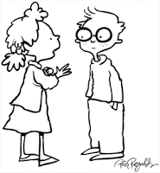
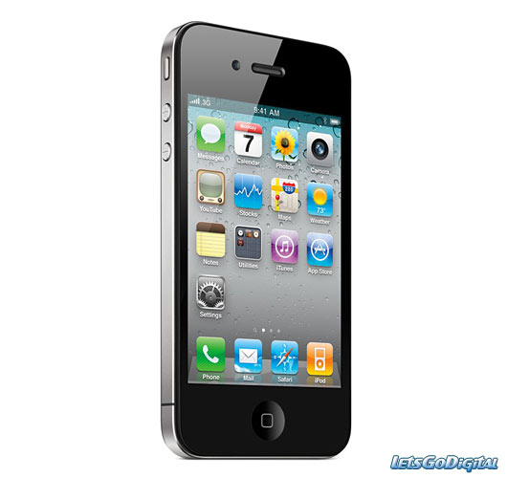

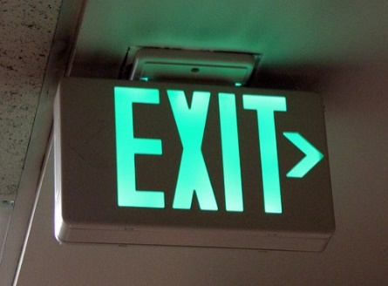

TTL- Strategy
Tell
Take
Look

Slide 12
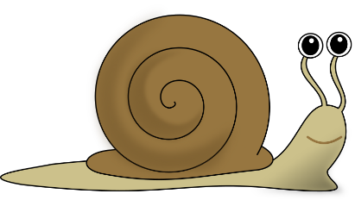

Relationships are built slowly and over time
An acquaintance is a stranger. You may recognize an acquaintance or even know their name but they aren’t a close or evolving friend. Why?
Even if you have known someone online for a while, they are still a stranger. Why?
Can relationships with acquaintances lead to friendships? Yes/no and Why?

Slide 13
Snail Trail Situation
Phil is very attracted to girls with red hair. Sometimes when he sees a girl with red hair, he will stand by her side and stare, especially if he thinks that he knows her. Phil will look at her for a long time without moving his eyes or talking to her.
What is he doing? How does that make the person feel? What rating would the person give him?

Slide 14
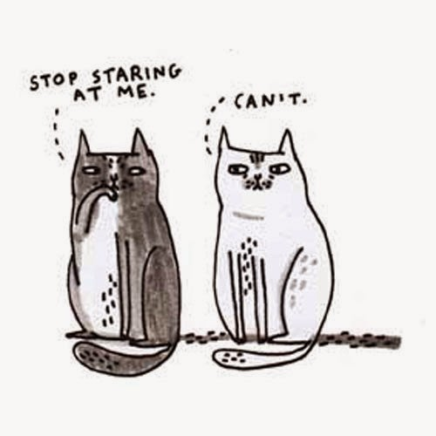
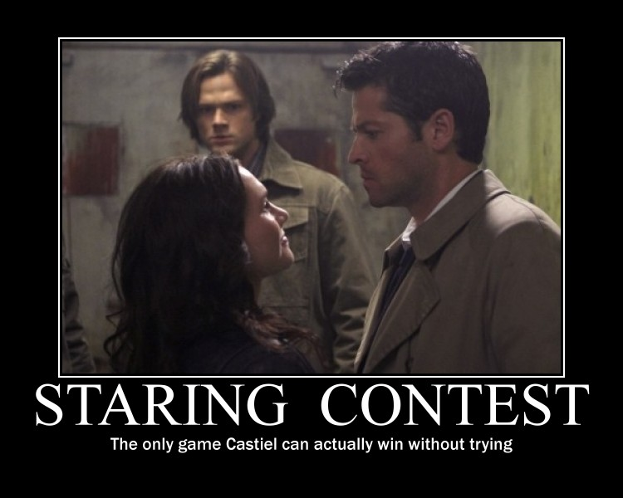

Staring

Slide 15
Staring Videos
Staring
Prankster staring
Staring 2

Slide 16
Staring- What should you do if you find yourself staring?
Look away or look at something else
Introduce yourself
Compliment the person or apologize
Start a “small talk” conversation (e.g. talk about the weather)

Slide 17
Snail Trail Situation
Julie works at the grocery store. During her break, she follows John into the break room and stares at him. John notices Julie staring at him and he immediately leaves the room.
What is she doing? How does that make John feel? Why do you think John left?

Slide 18

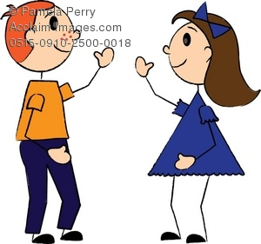
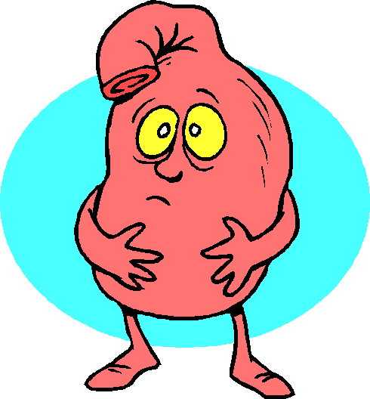
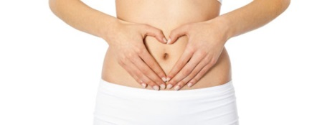
Personal Safety
Not all strangers are unsafe
Not all familiar people will have your best interest in mind
Need to learn what type of stranger is unsafe and how to pay attention to our
“Gut feelings”

Slide 19

Gut Feeling- Inner Voice
Internal safety check
Helps us figure out other people’s intentions and motives
Listen to Your Little Voice

Slide 20

Don’t Ignore Your Gut…..
Just because you are trying to be:
Polite
Don’t know how to get out of the situation
Feel Peer Pressure

Slide 21



When Something is Wrong…
Pay attention
Consider options
Take ACTION

Slide 22

Situations That Cause Alarm

Slide 23

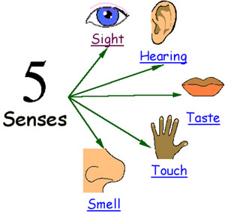
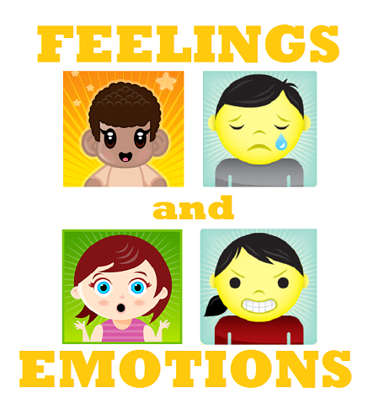
What does your gut tell you?
Thoughts
Body Sensations
Feelings

Slide 24
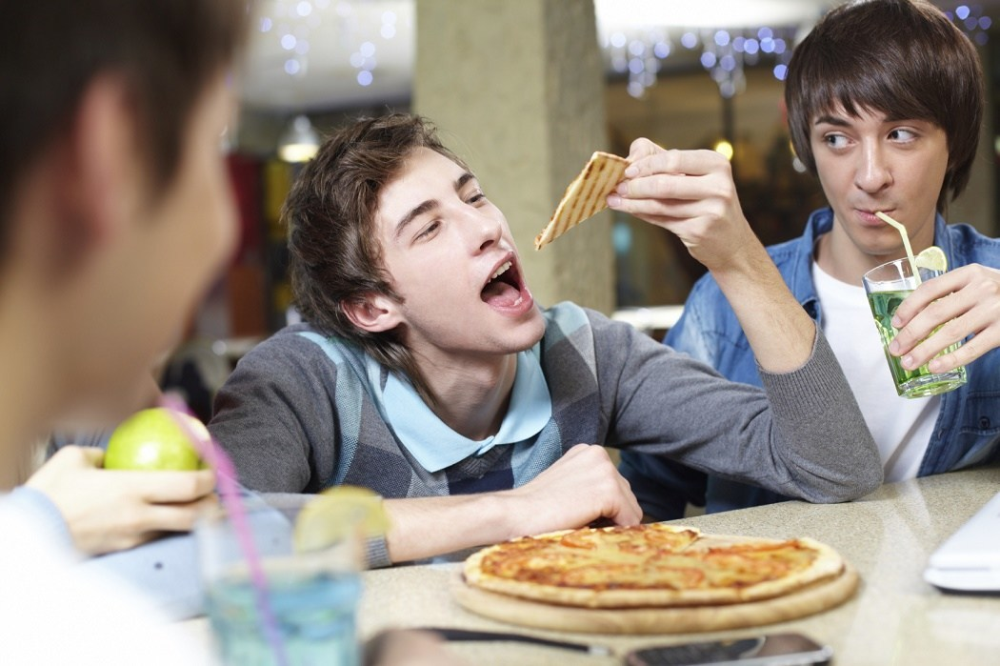
What does your gut tell you?

Slide 25
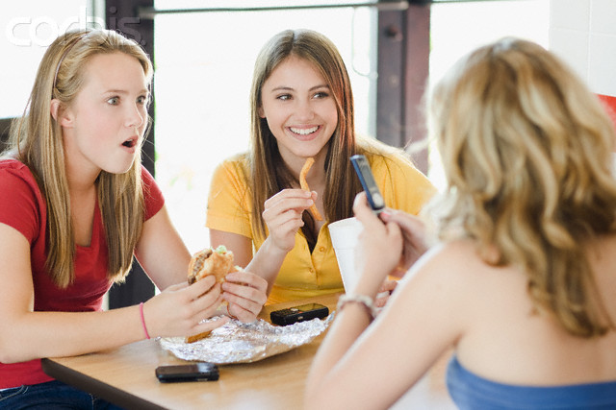
What does your gut tell you?

Slide 26
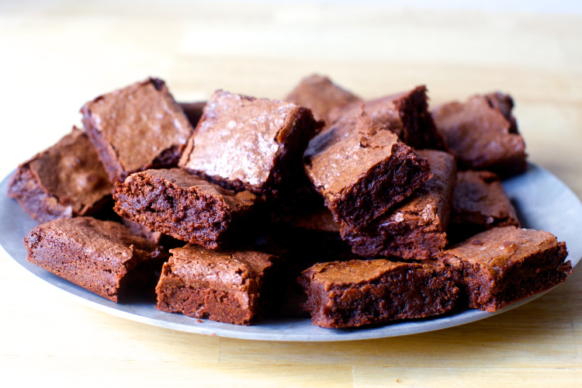
What does your gut tell you?
You are invited to a friend’s home and when you get there your friend has made brownies.

Slide 27
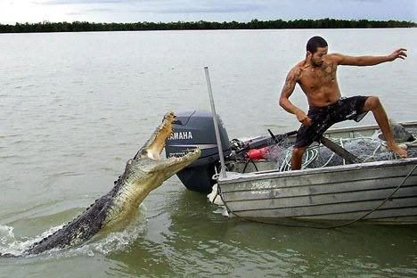
What does your gut tell you?

Slide 28
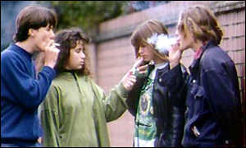
What does your gut tell you?

Slide 29
What does your gut tell you?
You arrive at a party and immediately notice a weird smoky smell. You see empty bottles and people who are acting strange.

Slide 30
What does your gut tell you?
You are at the beach with a group of friends and an acquaintance of yours offers you a soda. You take a drink and notice that something is not right about the taste.

Slide 31
Healthy Relationships

